Slide 1
Pricing Strategies
Pricing Strategies : Revision
A profit maximizing firm's behavior satisfies two basic rules.
Rule 1: MR = MC
This rule tells us a lot about how the firm's optimal profit and output varies.

Slide 2
Pricing Strategies
Pricing Strategies : Revision
A profit maximizing firm's behavior satisfies two basic rules.
Rule 1: MR = MC
This rule tells us a lot about how the firm's optimal profit and output varies.

Slide 3
You can figure out price from MR=MC
MC
MR
Optimal Quantity

Slide 4
First notice that demand/price is above MR
This is because you must cut price to sell extra units.
MC
Demand
MR
Optimal Quantity

Slide 5
You can figure out price now from optimal quantity
MC
Optimal Price
Demand
MR
Optimal Quantity

Slide 6
You can also plot costs per unit or AC
MC
Optimal Price
AC
Demand
MR
Optimal Quantity

Slide 7
Now we can figure out profit per unit
MC
Optimal Price
AC
Demand
MR
Optimal Quantity

Slide 8
An increase in demand can reduce price.
MC
AC
Old MR
Old Demand

Slide 9
An increase in demand can reduce price.
Note: Here the new demand is much flatter and quantity has gone up.
New
Demand
New MR
MC
AC
Old MR
Old Demand

Slide 10
An increase in demand can increase price.
.
MC
AC
Old Demand
Old MR

Slide 11
An increase in demand can increase price.
Note: Here the new demand is steeper.
New
Demand
New MR
MC
AC
Old Demand
Old MR

Slide 12
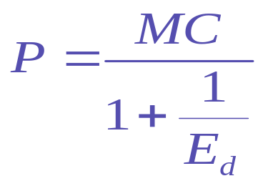
Rule 2 :
It is this rule that tells us about pricing.
As marginal cost goes up so do prices.
If demand becomes more elastic (the elasticity moves from –3 to –4 for example) so prices go down.
Steeper demand curves have higher prices.
Flatter demand curves have lower prices.
This is what is going on the in the previous examples.

Slide 13
Monopoly Power
Pure monopoly is rare but firms do face downward sloping demand curves. As one firm varies its price there will be a change in the demand the firm experiences.
The individual firm's demand is more responsive to price than the market demand, but as long as demand does not entirely vanish when it raises its price the firm enjoys some monopoly power.

Slide 14
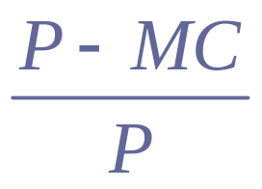
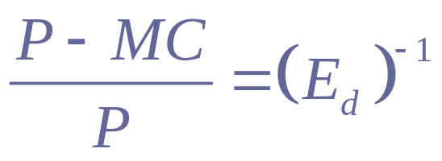
Measuring Monopoly Power
Lerner's Measure L =
If the firm is maximizing profits
where the elasticity is the firm's elasticity of demand not the market's.

Slide 15
Sources of Monopoly Power
What determines the firm's elasticity of demand?
The Elasticity of Market Demand
(Oil vs. Coffee)
(Local Monopolies)

Slide 16
Sources of Monopoly Power
What determines the firm's elasticity of demand?
The Elasticity of Market Demand
(Oil vs. Coffee)
(Local Monopolies)
The number of firms
Barriers to entry:
1. Legal,
2. Scale,
3. Technological,
4. Strategic.

Slide 17
Sources of Monopoly Power
What determines the firm's elasticity of demand?
The Elasticity of Market Demand
(Oil vs. Coffee)
(Local Monopolies)
The number of firms
Barriers to entry:
1. Legal,
2. Scale,
3. Technological,
4. Strategic.
Strategic Behavior of other firms

Slide 18
The Problem of Setting One Price
If a firm sets one price, there are usually customers willing to pay more.
P
This customer is willing to pay this much extra.
Q

Slide 19
Price Discrimination
Price Discrimination occurs when a firm sells the same good at different prices to different customers.
  Airlines(Business/Vacation)
  Hotels(Business/Vacation)
  Drugs (Generic/Branded)
  Telephone Companies (Fixed Fee and Call charges)
  Service provides Fixed fee and per unit cost (IBM/Xerox)
  Manufacturers(Offer high initial prices and lower ones later)
  Businesses(offer student discounts)
  Manufactures (Retail/Wholesale)
Firms do this to try to capture part of the consumer surplus; this is not a bad thing as generally it increases supply.
(Why? Firms increase profits.)

Slide 20
Necessary Conditions
Can identify at least two market segments with different elasticities.
  Personal Characteristics
  (Dry Cleaning/Haircuts)
Can enforce it – so higher price buyers cannot buy at the lower price.
  Must also prevent low price types reselling to higher price types.
  Services

Slide 21
Types of Discrimination
First Degree Price Discrimination:
The firm sets a different price for each customer. (Auto dealers, dotcoms?, telephone companies, college tuition).
In practice very unlikely, cannot find out customers true value.
This theoretical extreme would maximize profit.
P
This customer pays this much.
Q

Slide 22
Second Degree Price Discrimination
The firm is able to charge a price that depends on the quantity purchased (e.g. quantity discounts).
Example Block Pricing by Power Generators
The firm charges P₁for the first 100 units P₂ for the next 100 and P₃ for the next 100.
P₁
P₃
100
200
300

Slide 23
Two Part Tariffs
One common form is two-part pricing P=A+pQ,
where A is a fixed fee (connection charge, membership fee, admission charge) and p is the price for units.
Average price =(A+pQ)/Q declines in Q. Effectively high usage customers pay less per unit than low usage consumers.
Examples : Theme Parks, Utilities…

Slide 24
How do Firms Set the Entry Fee?
If there is only one type of buyer or if all buyers are the same.
Fee = consumer surplus and price =MC.
With more than one type of consumer, there is a trade off higher entry fees against lower per-unit prices. It is very hard to find the optimal strategy in practice.
Basic rule is that at the price charged the entry fee should equal the consumer surplus of the marginal type buyer.

Slide 25
Forms of Two-Part Tariffs
Offering menus of entry fee
Example China Mobile Co.
Access fee 0 50 388 568 788
Allowance 0 0 1000 1700 2588
Extra Mins 0.6 0.4 0.4/0.2 .35/.18 0.3/0.15
Offering quantity discounts when you buy entry (get several free units up from as well as paying the entry fee).

Slide 26
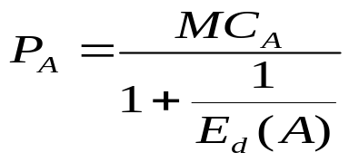
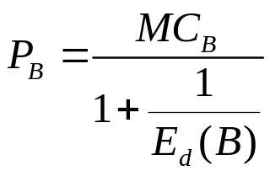
Third Degree Price Discrimination
The firm is only able to broadly divide a market in segments and charge these segments different prices. It is time to recall the basic rules of price setting.
If a firm supplies two markets A and B, then to maximize profits it wants to set either:
MR_{A} = MC_{A} and MR_{B} = MC_{B}
Or
and

Slide 27
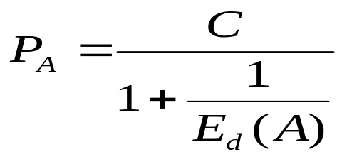
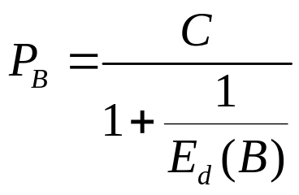
The Case with Same Costs
One important distinction is if the firm has the same costs of supplying market A and B. Costs will be the same if the product is identical and sold in similar geographic locations.
Examples of this are Restaurant Pricing Airline Pricing, Hotel Pricing
but Dry Cleaning and Haircutting may not be.
Let MC be constant and equal to c
Here you should charge the most price sensitive customers least.

Slide 28
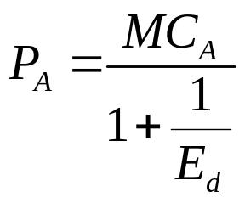

Cost Differences
Peak Load Pricing
• Utilities, service industries and holiday resorts all experience peaks in demand, which are very expensive to meet.
• This leads providers to raise prices at times when marginal cost is very high.
Suppose that market A and market B have the same elasticities but different cost of supply, then the optimal prices ought to satisfy
and
General Rule : Higher MC implies higher prices.

Slide 29

Cost and Demand Differences : Multinational Production
(Monsanto and Roundup Ready Soya?)
Suppose the firm is charging optimal prices in market A(Argentina?) and market B(USA), then
and
• The demand in Argentina is more elastic than that in the US, so this should lead to lower prices there.
• But if Argentina has a higher cost of supply (if the grain is exported from USA) then the prices should be higher there. There are two conflicting effects.
Note: If grain is produced locally and is cheaper to produce in Argentina then they should bear lower prices.

Slide 30
Intertemporal Price Discrimination
• Often companies use time to discriminate between high and low-value consumers. Those consumers who are willing to wait for a low price are more price sensitive than those who are not.
• Problem : If consumers anticipate a price fall they will not buy today.
(UK car market)
• Leasing is useful way for firms to commit to not engage in future price cuts because then are obliged to cut prices to those who have already bought the good as well as to new customers.

Slide 31
Product Bundling: General Theory
There are two goods A and B. Let us graph peoples' willingness to pay for good A on the horizontal axis and for good B on the vertical axis.
+
+
P_{B}
+
+
+
+
+
+
Willingness to pay
for good A
P_{A}
P_{Bundle}

Slide 32
If individuals' preferences have a scatter plot with a negative slope, it is more profitable to bundle.
If preferences have a positive slope, then bundling may not be profitable.
+
+
+
+
+
+
+
+
+
+
+

Slide 33
Firms may want to offer bundles and single units if some consumers must be excluded from buying the bundle because of costs
Cost of Good A
+
+
+
+
+
Cost of good B
+

Slide 34
In this case should offer a bundle and individual units.
.
Cost of Good A
Price good A
+
Price good B
+
+
+
+
Cost of good B
+

